Slide 1
Communicative Language Teaching (CLT)
Communicative Language Teaching
p. 14-27

Slide 2
History of CLT
Reaction to inadequacies of four skills model
Did not illustrate negotiation of meaning
Active Skills
Speaking
Writing
Passive Skills
Reading
Listening

Slide 3
Negotiation of Meaning
An effort to reach mutual comprehension through:
  restating
  clarifying
  and confirming information
Active/Passive dichotomy
Does not capture interaction

Slide 4
Example of Negotiating meaning
Watch this clip.
What features of negotiating meaning to do you see?
    Restating information
    Clarifying information
    Confirming information
Negotiating Meaning Video

Slide 5
Communicative Competence (CC)
Ability to function in communicative setting
  Grammar knowledge PLUS
    Gestures
    Intonation
    Strategies for making oneself understood
    Risk-taking to attempt communication
    (Shrum & Glisan, 2005)

Slide 6
Four Components of CC
Grammatical- form
  past tense of run is ran
  To make a noun plural add –s
    coat/coats
Knowledge of rules ≠ ability to use

Slide 7
Four Components of CC
Discourse Competence- oral/written text level
Poems, sportscasts, compositions, essays, research papers
Top-down processing
  Thematic understanding
  Overall interpretation
Bottom-up processing
  -Unit level
  -Collection

Slide 8
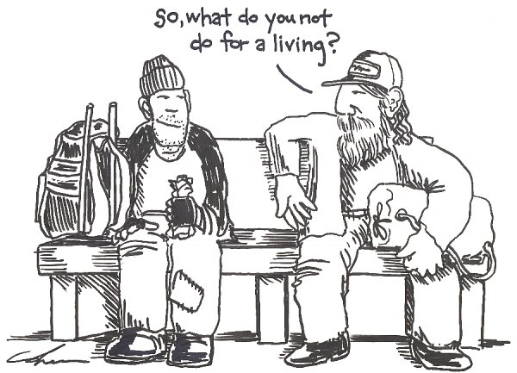
*Social rules
*Nonverbal language, turn-taking, appropriacy of content
*Relies heavily on CONTEXT
Sociocultural Competence
*
Cartoon courtesy of : Some kind of strange blog retrieved 5/24/2011 http://kostylomusic.blogspot.com/2010/05/dont-you-hate-all-those-clever-people.html

Slide 9
Four Components of CC
Strategic Competence- coping strategies
Communication despite deficiencies in other competencies
Ex: what do you do when you forget the word you want to say?

Slide 10
Putting it all together
Five components
Bottom line
Be creative
Know your learners
Consider your context and training
Seek support of others

Slide 11
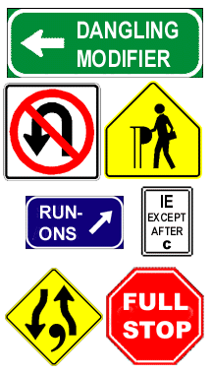
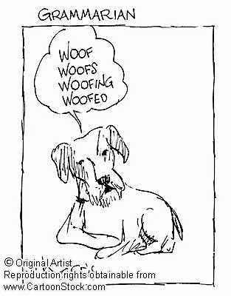
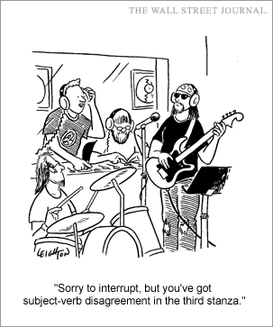
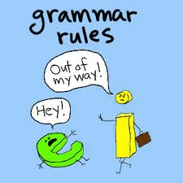
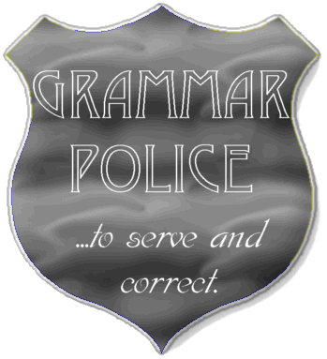
Grammar and CLT
Concerns about accuracy
Revisits form vs. use debates

Slide 12
You should remember
Communicative Competence is
  Communication within a meaningful context
  More than grammar, but grammar is important
  Making meaning using grammatical forms
  “Integration of form-focused exercises with meaning-focused experience.”
  Dr. Jack Richards

